Slide 1
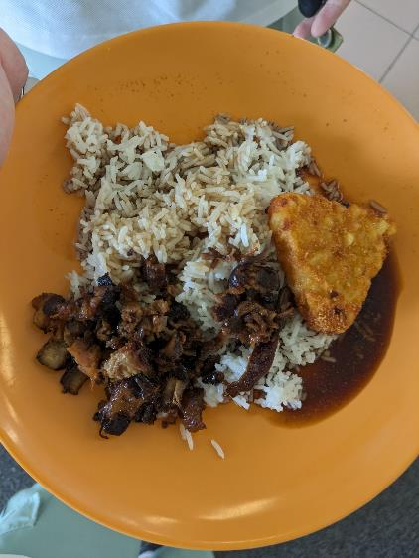
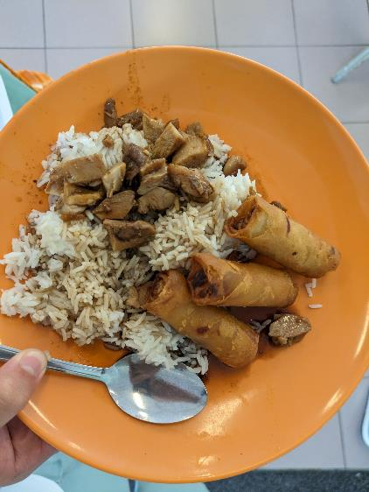
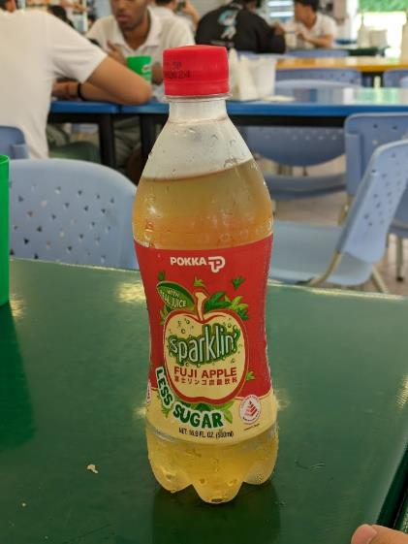
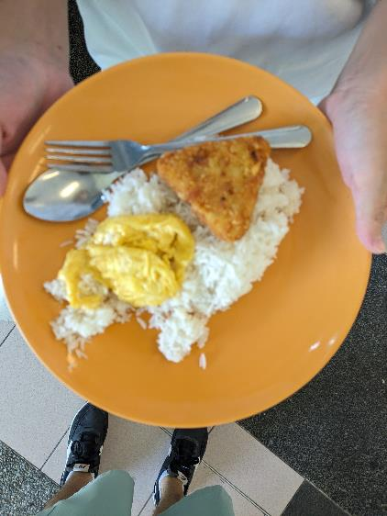
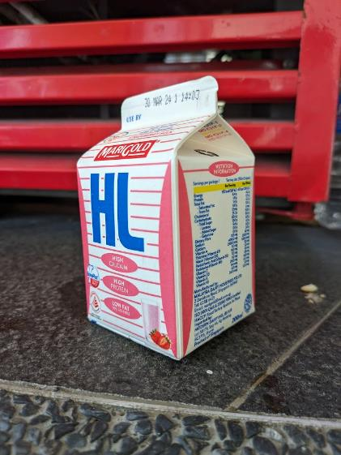
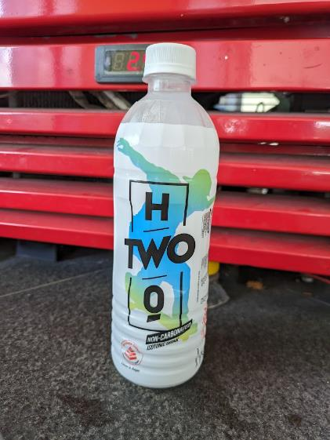
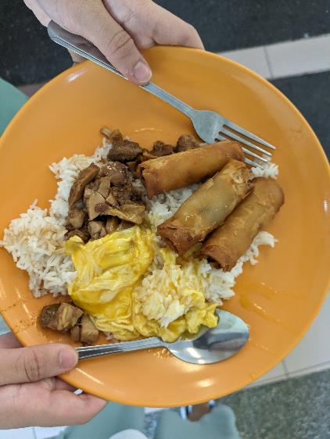
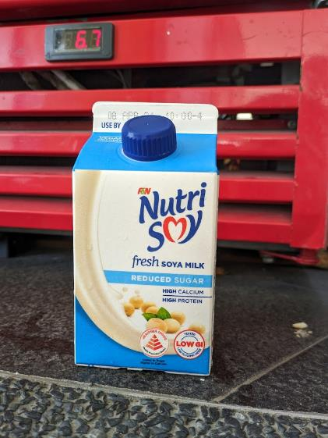
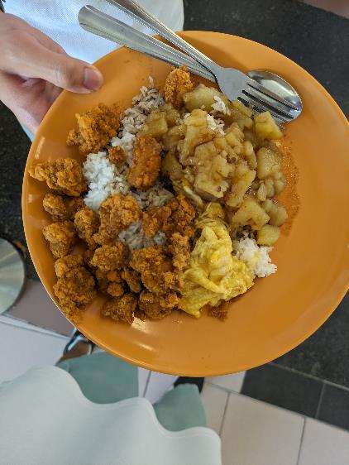
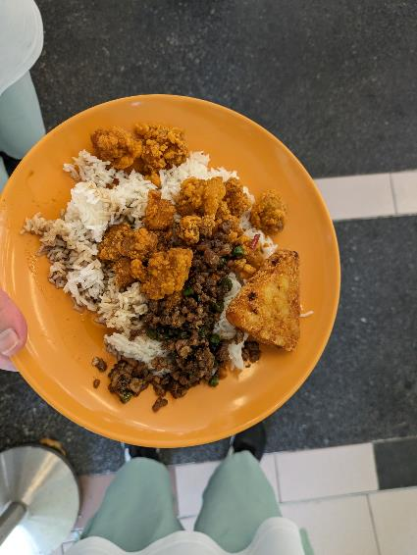
NUSHFood
Hiuk Ming Hong
Wong Yue Heng

Slide 2
NUSHFood
Hiuk Ming Hong
Wong Yue Heng

Slide 3
PROBLEMS
EPS Causes Finger Pain
Payment slows system
Cash has germs

Slide 4
SOLUTION
No physical contact
No stallholder interaction
No cash needed (we live in the future)

Slide 5


Models Used
Drinks – CNN
Food – image Segmentation

Slide 6

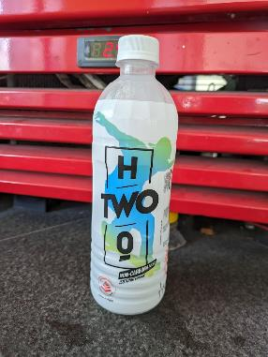
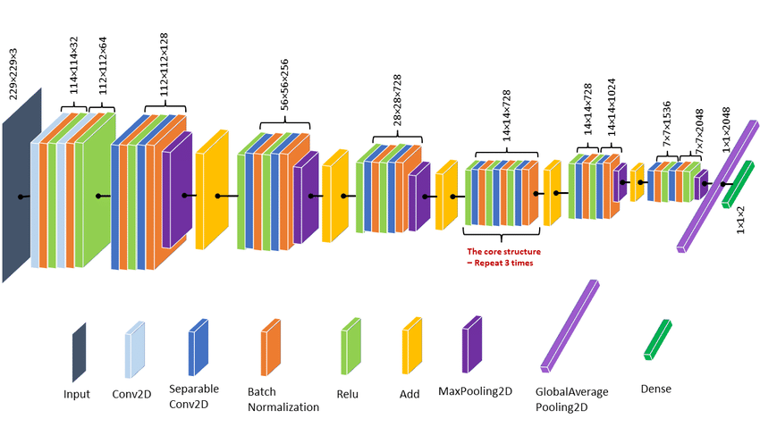
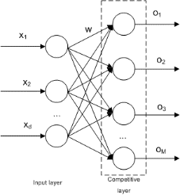
CNN Topology
Rescaling & Augmentation
Xception Filters
Dense Layer, Output
Image

Slide 7
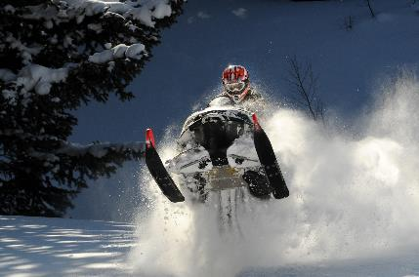
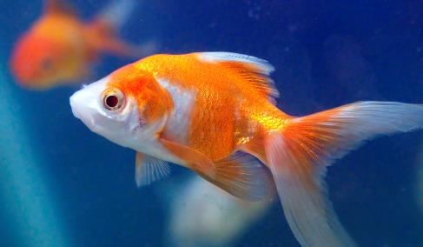
CNN Topology
Pre-trained on ImageNet
Good at differentiating:
Xception Filters

Slide 8
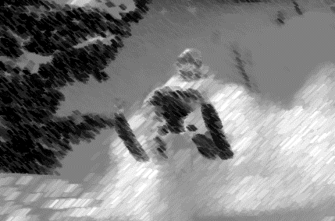
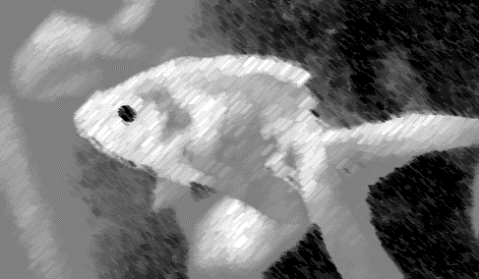
CNN Topology
Pre-trained on ImageNet
Good at differentiating:
Samples easy to differentiate without color
Xception Filters

Slide 9
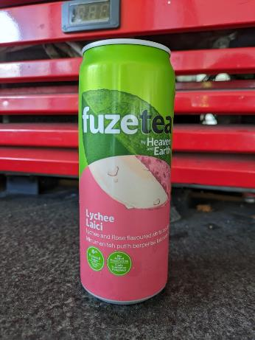
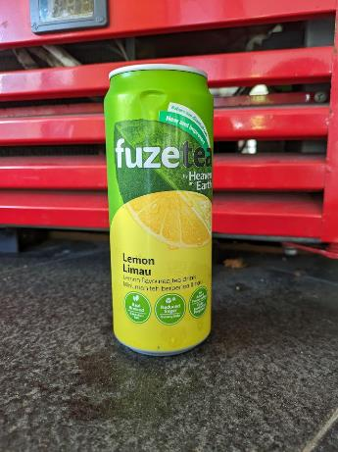
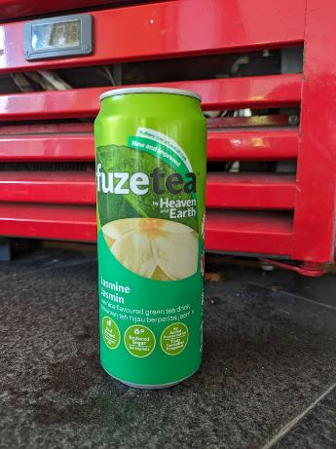
CNN Topology
Xception Filters
Can you tell the difference?

Slide 10
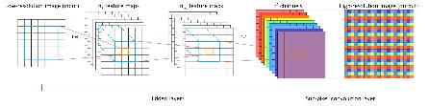
CNN Topology (v2)
Xception Filters
Rescaling & Augmentation
Dense Layer, Output
Image
Custom CNN

Slide 11
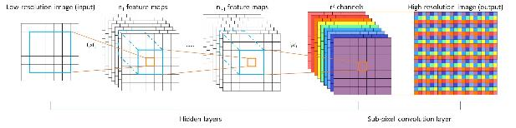


CNN Topology (v2)
It worked good
Like really good
100% accuracy level good
Overfit
Custom CNN

Slide 12


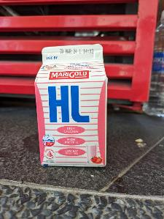

CNN Topology (v2)
The background of the image also matters when using a low-complexity model…
Custom CNN

Slide 13
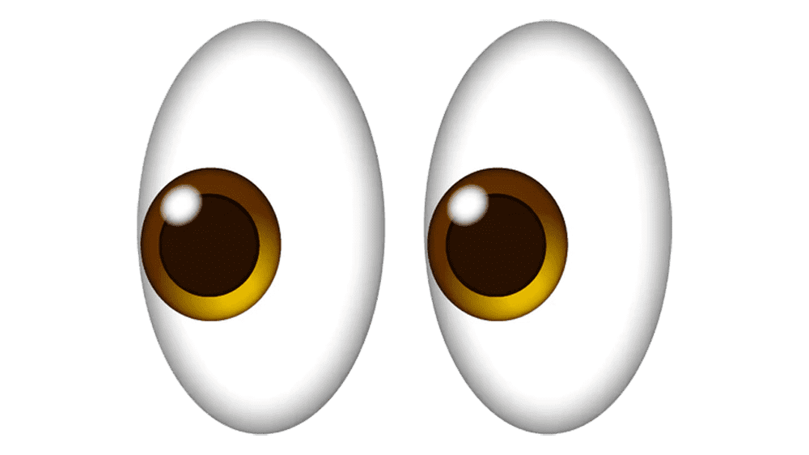

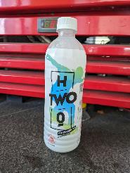
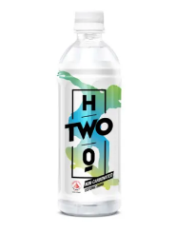
CNN Topology (v3)
Xception Filters
Rescaling & Augmentation
Dense Layer, Output
Image
Custom CNN

Slide 14
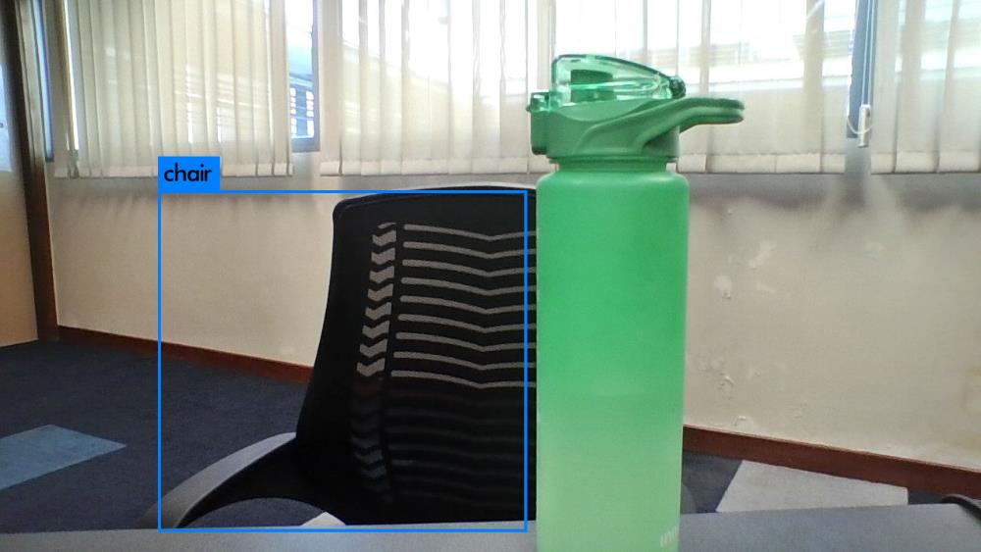

Failed attempts and the friends we made along the way
Preprocessing images: bounding box
Darknet 😎
https://pjreddie.com/darknet/yolo/

Slide 15
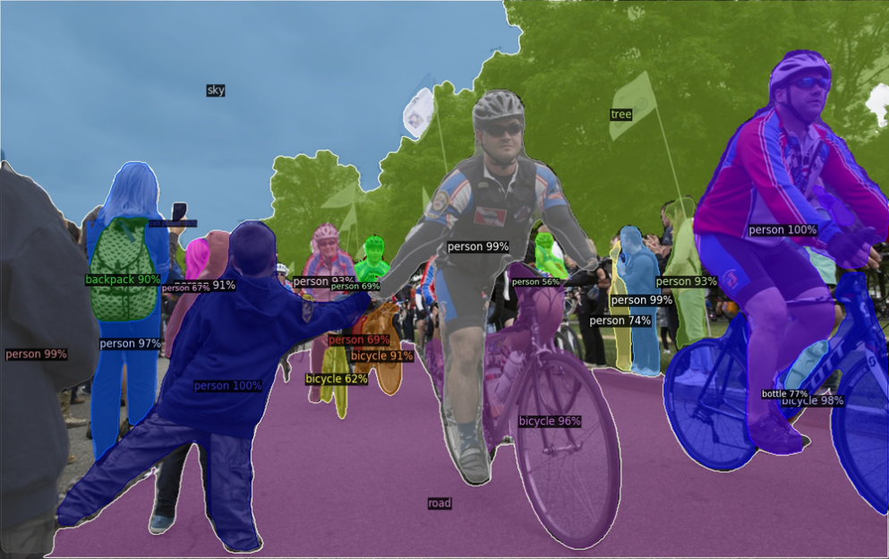

Image Segmentation with Detectron2

Slide 16
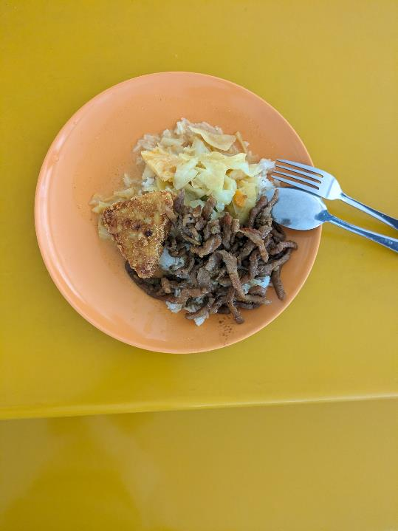
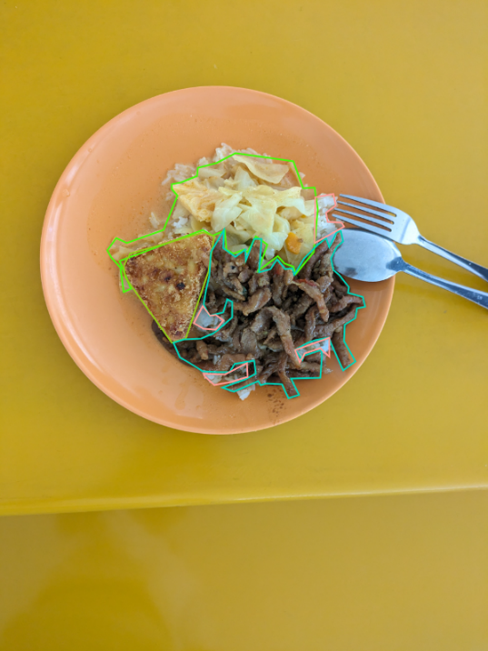

Labelling Images

Slide 17

Labelling Issues
Scrambled Eggs and Rice kept on being switched

Slide 18

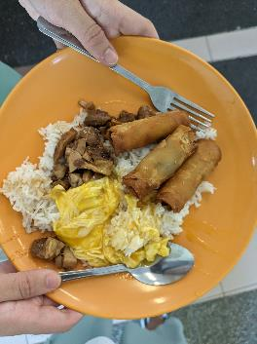
Results
Drinks 97% Recall
95% Precision
Food
All food items in testing images identified

Slide 19





The app
app

Slide 20
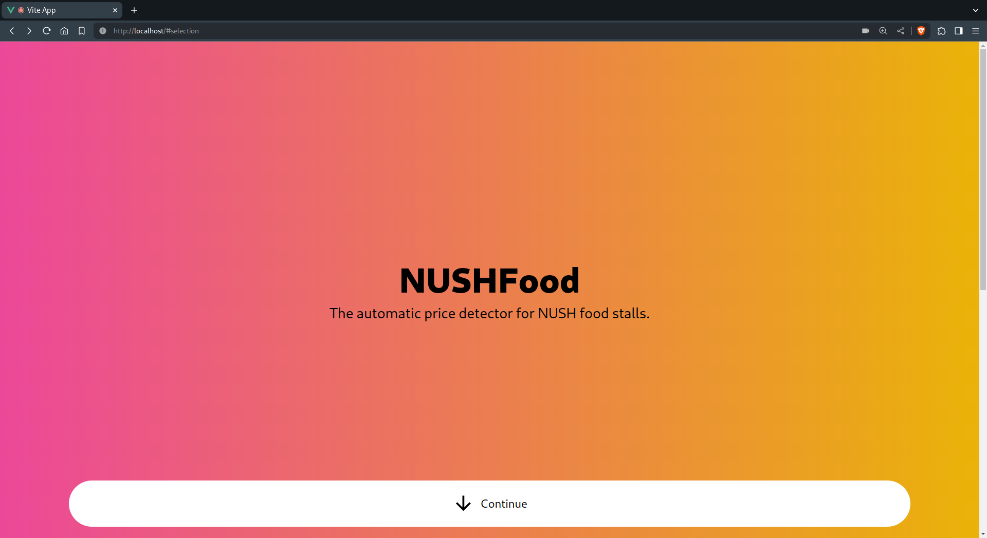

Slide 21
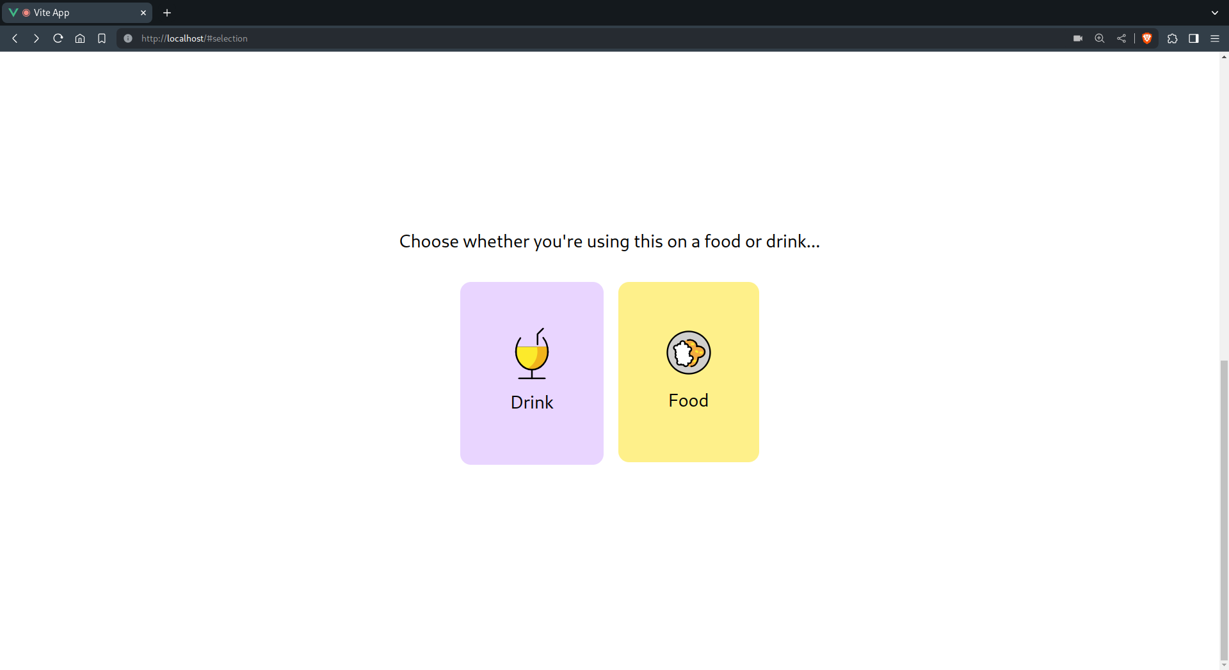

Slide 22
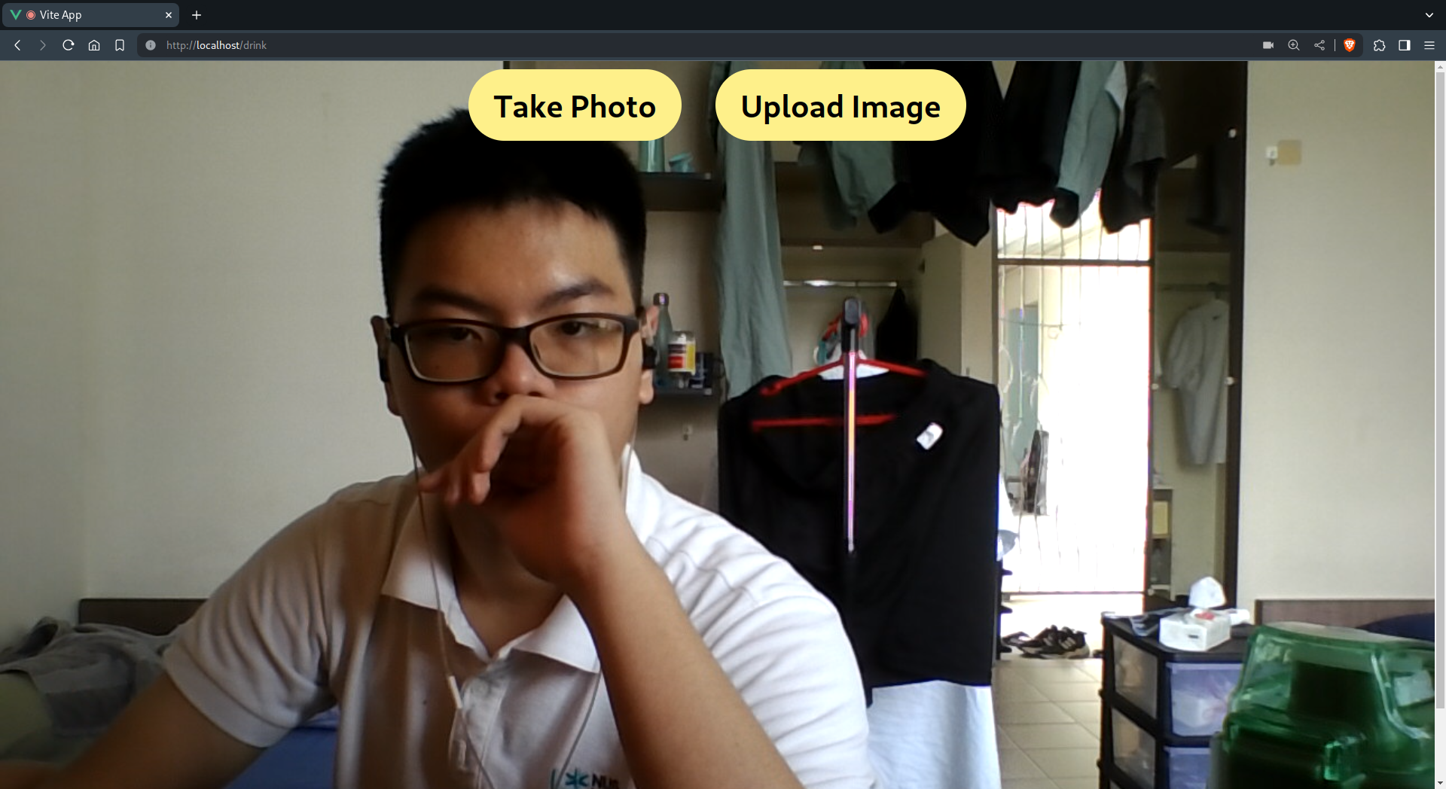

Slide 23
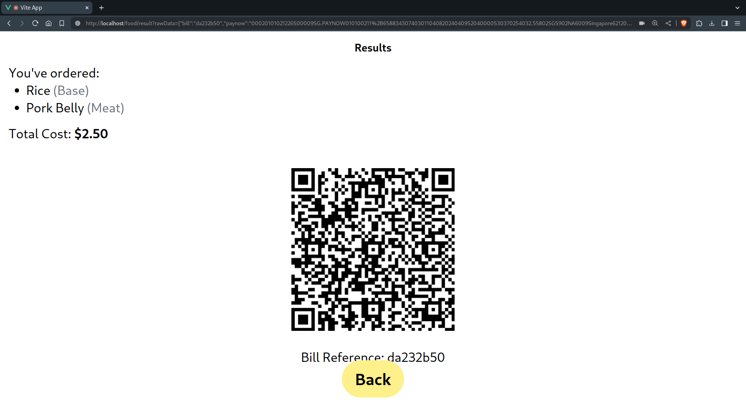

Slide 24
Live Demo

Slide 25
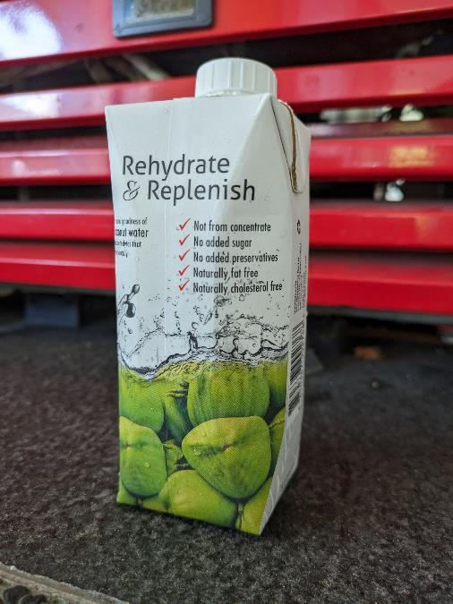
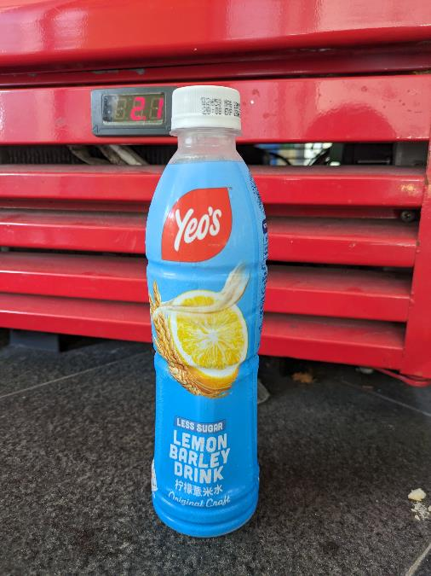
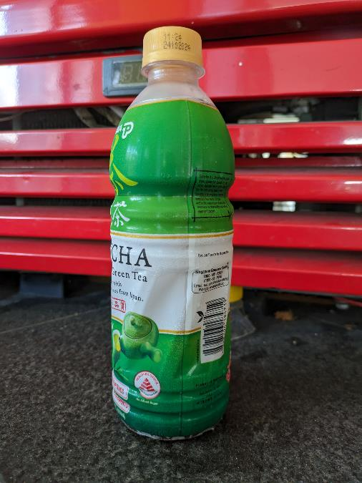

Slide 26
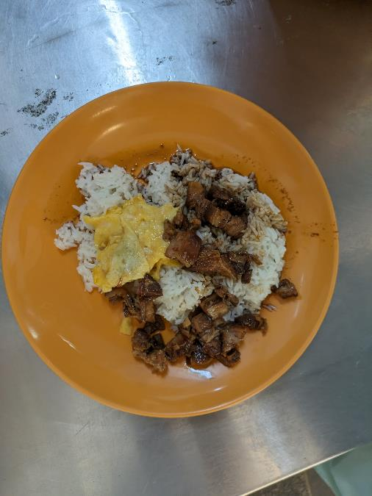
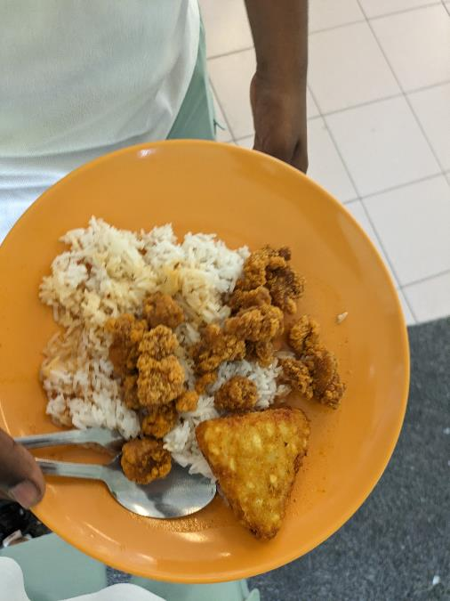
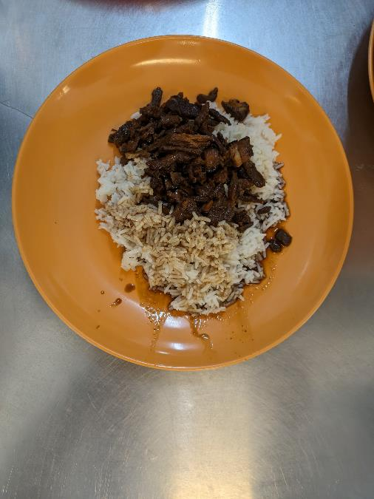

Slide 27
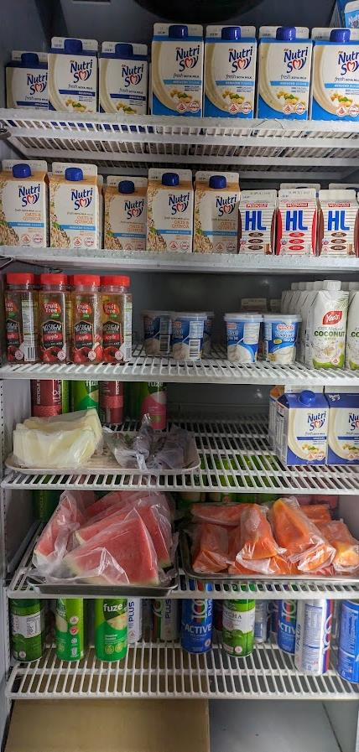
Thank You
Any questions?

